Slide 1
Christmas Movie Trivia!

Slide 2
What is the dad’s
name in home alone?

Slide 3
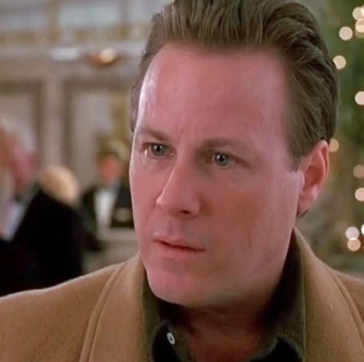
Peter Mcallister

Slide 4
Movie Clip

Slide 5
What kind of candy was in buzz’s stuff?

Slide 6
Junior Mints

Slide 7
What movie features an elf named Bernard?

Slide 8
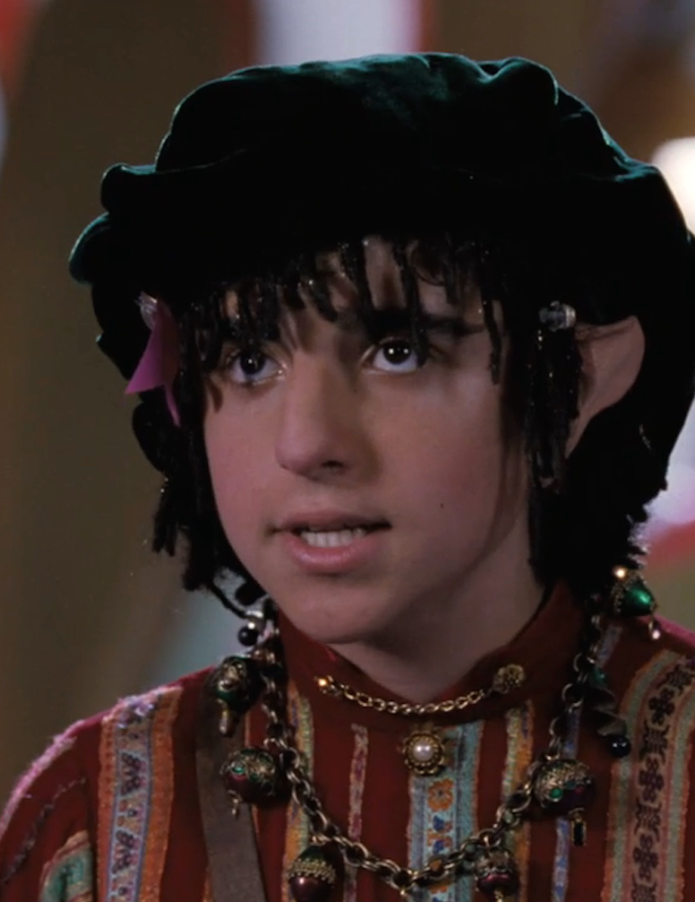
The Santa Clause

Slide 9
In the movie “jingle all the way”, what is the name of the action figure the dad is trying to find?

Slide 10
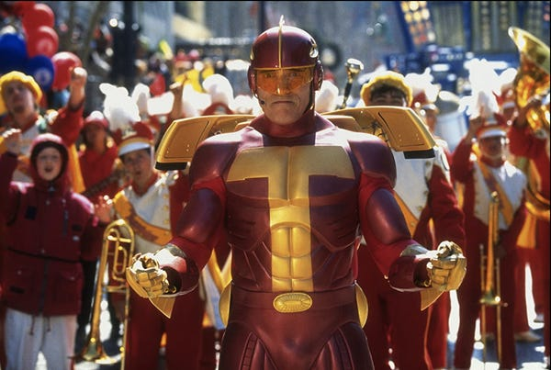
Turbo
man

Slide 11
What is the highest grossing Christmas movie of all time?

Slide 12
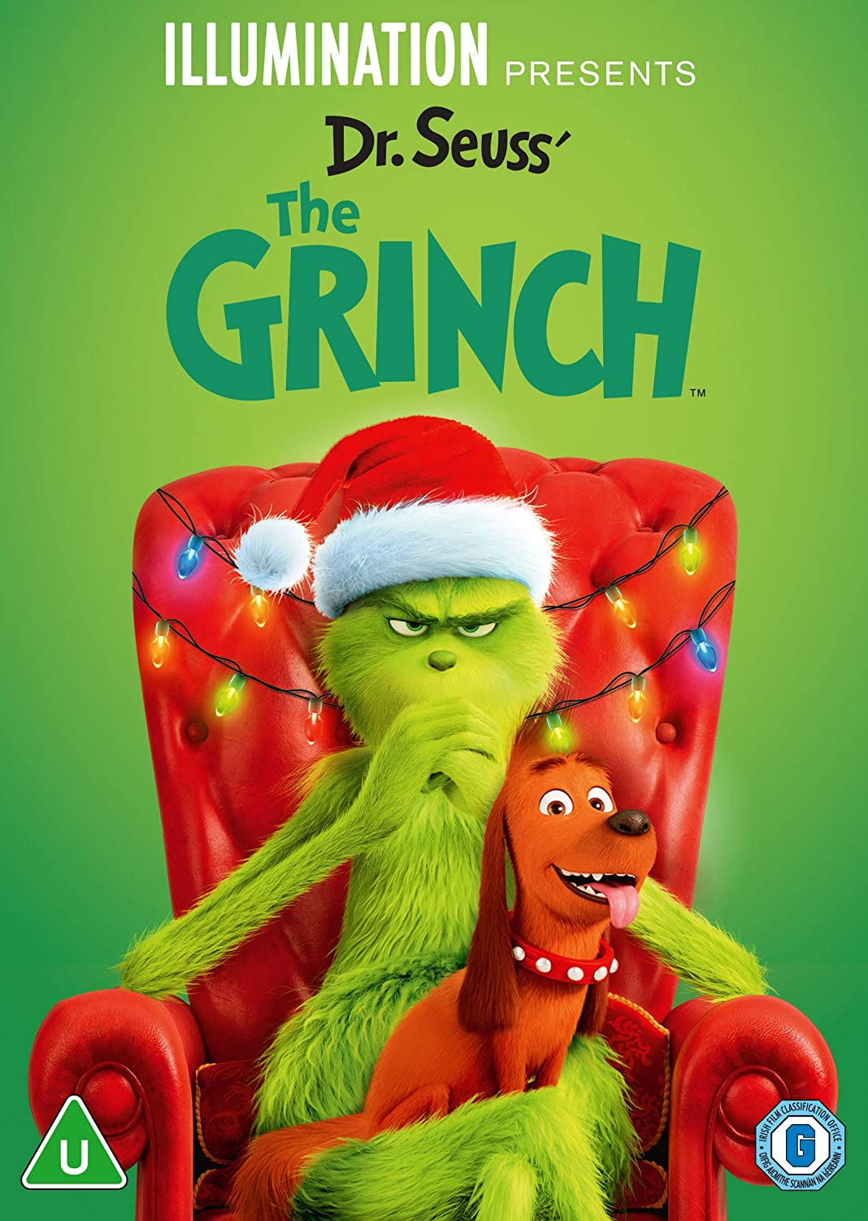
Dr. seuss’
The grinch
(2018)
512 million

Slide 13
In a Christmas story, What was the secret message Ralphie deciphered from the Little Orphan Annie radio show?

Slide 14
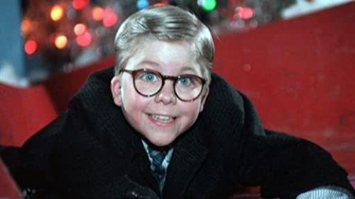
“Be sure to drink your ovaltine”

Slide 15
In the nightmare before Christmas what does jack call santa claus?

Slide 16
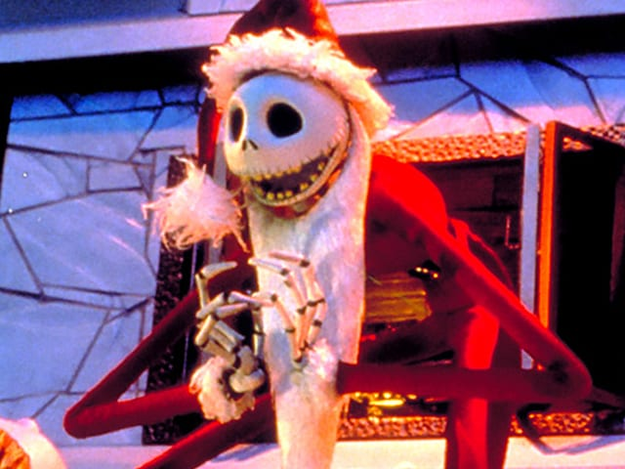
Sandy
Claws

Slide 17
Which 2005 christmas time movie featured Ryan Reynolds?

Slide 18
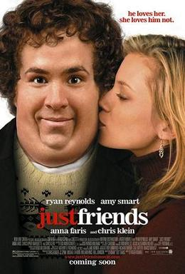
Just Friends

Slide 19
In 1988, what christmas movie was Alan rickman in?

Slide 20
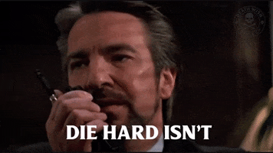
DIe hard!

Slide 21
What is the name of the department store where buddy meets Jovie in elf?

Slide 22
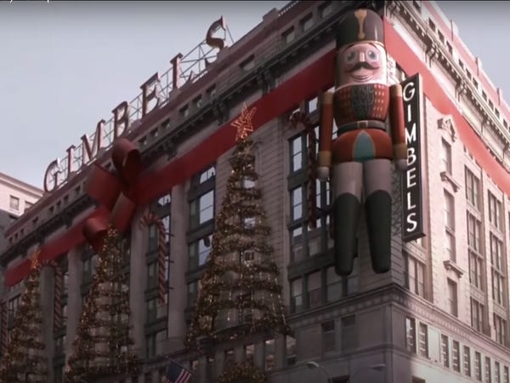
Gimbels

Slide 23
In the Disney original movie, the ultimate christmas present, what did Allie steal from santa?

Slide 24
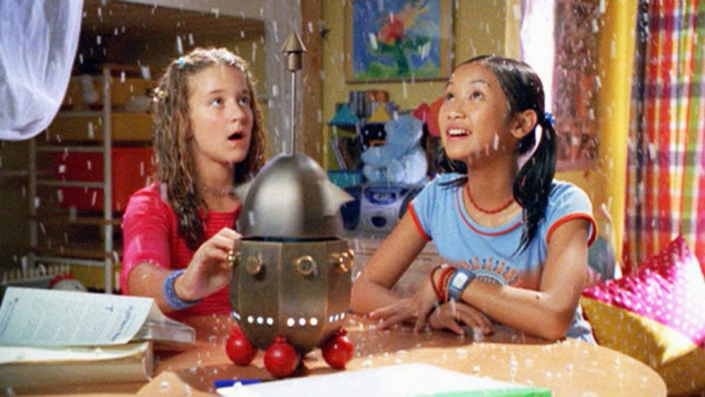
A weather machine

Slide 25
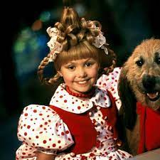
The actress who plays Cindy Lou who in how the grinch stole christmas, is also in what popular 2007 television show?

Slide 26
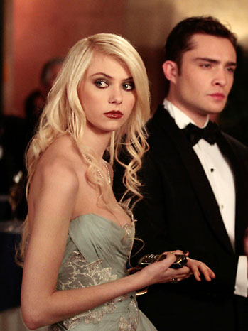
Gossip Girl

Slide 27
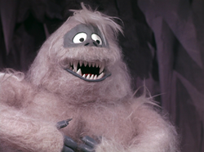
In The movie Rudolph the red nosed reindeer, what do bumbles do?

Slide 28
Bumbles Bounce!

Slide 29
THe end!

